Slide 1
Malware: Malicious Software(1)

Slide 2
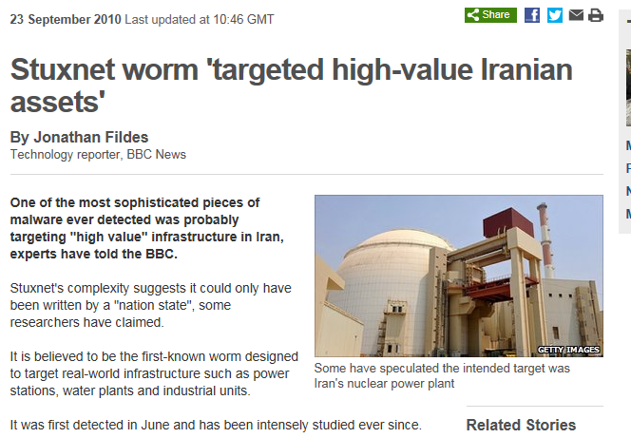
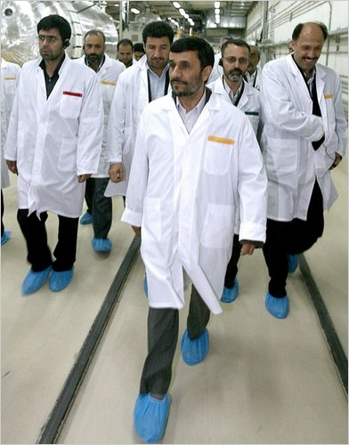
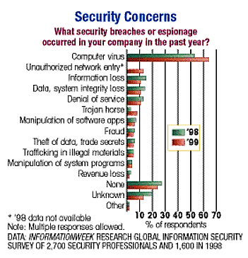
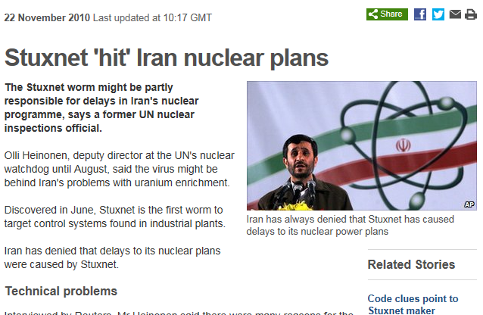
Notes:
The most pernicious [pə'niʃəs]computer virus ever known wasn't out to steal your money, identity, or passwords.The intricate['intrikət] Stuxnet virus’s target appears to have been the centrifuges in a top secret Iranian nuclear facility. Stuxnet showed, for the first time, that a cyber attack could cause significant physical damage to a facility. Does this mean that future malware, modeled on Stuxnet, could target other critical infrastructure such as nuclear power plants or water systems? Let’s watch a video first, and it will give us a best answer.

Slide 3
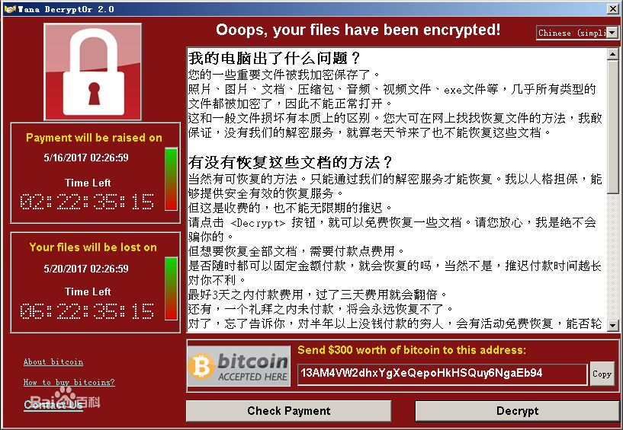

Slide 4
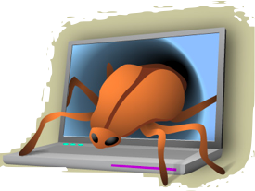
What is a malware?
A Malware is a set of instructions that run on your computer and make your system do something that an attacker wants it to do.
In other words, Malware is programming (code, scripts, active content, and other software) designed to disrupt or deny operation, gather information that leads to loss of privacy or exploitation, gain unauthorized access to system resources, and other abusive behavior

Slide 5
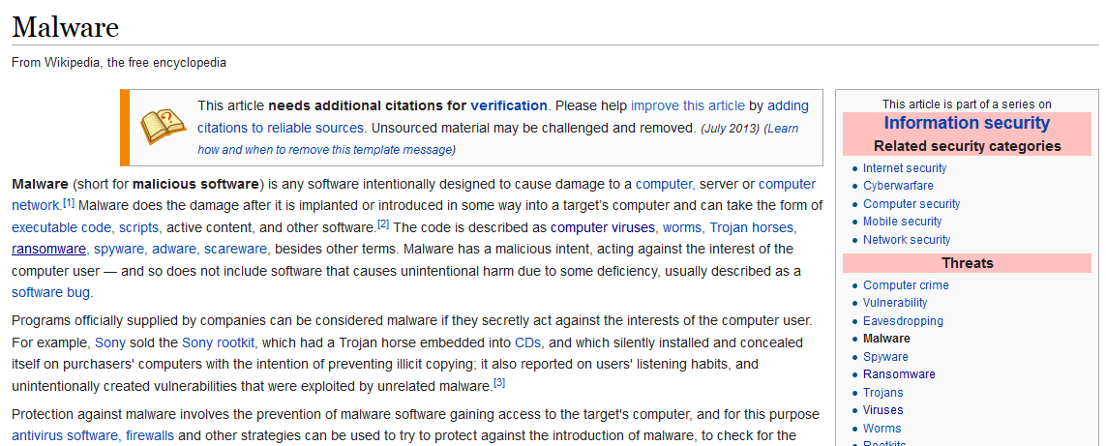
Malware From Wikipedia
Notes:
Let us see the concept of the Malware from Wikipedia. Wikipedia[viki'pidi:ə]
Malware, is software used or created by attackers to disrupt computer operation, gather sensitive information, or gain access to private computer systems. It can appear in the form of code, scripts, active content, and other software. Malware is a general term used to refer to a variety of forms of hostile or intrusive software.
Malware includes computer viruses, ransomware, worms, trojan horses, rootkits, keyloggers, dialers, spyware, adware, malicious BHOs, rogue security software, proprietary software, and other malicious programs; the majority of active malware threats are usually worms or trojans rather than viruses.

Slide 6
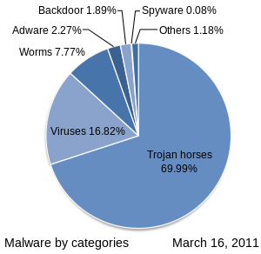
Malware From Wikipedia

Slide 7
What will malware do?
Steal personal information
Delete files
Click fraud
Steal software serial numbers
Use your computer as relay

Slide 8
Viruses, Trojans，Worms , Rootkits
Malware can be classified into several categories, depending on propagation and concealment Propagation
Virus: human-assisted propagation (e.g., open email attachment)
Worm: automatic propagation without human assistance
Concealment
Trojan: provides desirable functionality but hides malicious operation
Rootkit: modifies operating system to hide its existence
Various types of payloads, ranging from annoyance to crime
Notes:
viruses['vaɪrəs]
Trojans ['trəudʒəns]
propagation [,prɒpə'ɡeɪʃən]
concealment [kən'siːlm(ə)nt] n. 隐藏，隐蔽；隐匿处
desirable [dɪ'zaɪərəb(ə)l]
annoyance [ə'nɒɪəns] n. 烦恼；可厌之事；打扰
payload [‘peɪləʊd] n. 有效载荷，设计好的恶意操作
Malware can be classified into several categories, depending on propagation and concealment Propagation
Virus: human-assisted propagation (e.g., open email attachment)
Worm: automatic propagation without human assistance
Concealment
Trojan: provides desirable functionality but hides malicious operation
Rootkit: modifies operating system to hide its existence
Name derives from the wooden horse left by the Greeks at the gates of Troy during the siege of Troy
A Trojan horse program intentionally hides malicious activity while pretending to be something else
Usually described as innocuous looking, or software delivered through innocuous means which either allows to take control of systems
Trojan horse programs do not replicate themselves
Sometimes passed on using commonly passed executables, things like jokes forwarded by e-mail
Sometimes marketed/distributed as “remote administration tool”
Often combined with rootkits to disguise activity and remote access
Popularized to an extent by software like Cult of the Dead Cow’s Back Orifice, offered as a free download for running “remote administration” tasks or playing spooky jokes on friends
The line between user-launched worms and Trojans is highly blurred, with many user-launched worms behaving in a manner similar to worms.
Trojans are by definition malicious. The classic movie/television exploit of remotely opening disk drives is a definite symptom of being infected by a Trojan.
Have lately begun using much of the same defense mechanisms used by viruses, there are known Trojans which use WSH to run.
To detect infected computers, attackers often use so called sweep lists, list of IP addresses known to be online. One of the popular ways of doing this is to monitor IRC chat rooms and use the IP addresses of participants in these rooms.
Various types of payloads, ranging from annoyance to crime.
Payload examples
perform amusing or annoying pranks
destroy/corrupt files and applications
monitor and transmit user activity (spyware, logger)
install backdoor (makes the infected computer a zombie)
email spam
launch denial-of-service attack
alter browser settings to display ads
dial out international or 900 numbers (dialer)

Slide 9

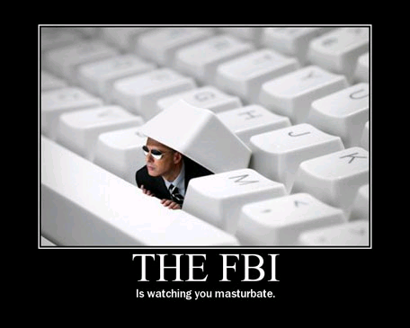
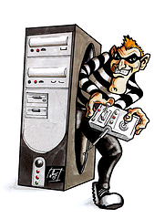
Backdoor/Trapdoor
A backdoor in a computer system (or cryptosystem or algorithm) is a method of bypassing normal authentication, securing remote access to a computer, obtaining access to plaintext, and so on, while attempting to remain undetected. The backdoor may take the form of an installed program (e.g., Back Orifice).
Notes:
A backdoor in a computer system (or cryptosystem or algorithm) is a method of bypassing normal authentication, securing remote access to a computer, obtaining access to plaintext, and so on, while attempting to remain undetected. The backdoor may take the form of an installed program (e.g., Back Orifice) or may subvert the system through a rootkit.

Slide 10
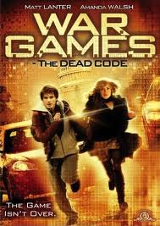
War Games(1983)
War Games is a 1983 American Cold War science-fiction film.
A young man finds a backdoor into a military central computer in which reality is confused with game-playing, possibly starting World War III.
The classic movie War Games features a backdoor at a dramatic high point. The backdoor in this case was a secret password that allowed access to a war-game simulation mode of a computer at the North American Aerospace Defense Command.
Notes:
Here we have an instance, the classic movie War Games features a backdoor at a dramatic high point. The backdoor in this case was a secret password that allowed access to a war-game simulation mode of a computer at the North American Aerospace Defense Command. War Games is a 1983 American Cold War science-fiction film.
A young man finds a backdoor into a military central computer in which reality is confused with game-playing, possibly starting World War III.

Slide 11
Easter Eggs
Software may include hidden features that can be accessed similarly to backdoors, known as Easter eggs.
Harmless.
Usually, unlocking an Easter egg in a program could cause the display of a joke, a picture of the programmer, or a list of credits for the people who worded on that program.
Notes:
Software may include hidden features that can be accessed similarly to backdoors, known as Easter eggs.
An Easter eggs is a harmless undocumented feature that is unlocked with a secret password or unusual set of inpus.
Usually, unlocking an Easter egg in a program could cause the display of a joke, a picture of the programmer, or a list of credits for the people who worded on that program.
In addition, movie DVDs sometimes contain Easter eggs that display deleted scenes, outtakes, or other extra content, by pushing unusual keystrokes at certain places on menu screens.

Slide 12
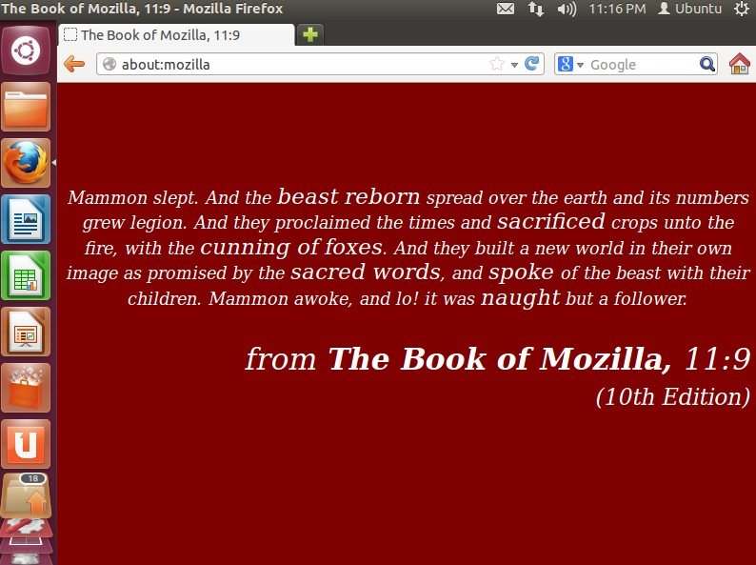
Example of Easter Eggs
Notes:
This picture is one kind of Easter Eggs in Mozilla Firefox.
When we input the string of “about:mozilla” in the address bar of Mozilla Firefox, we can find the easter eggs: a story about Mozilla.

Slide 13
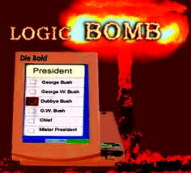
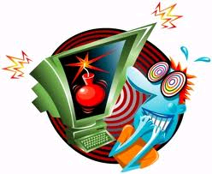
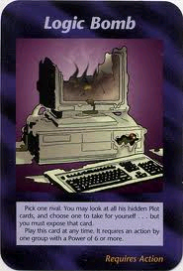
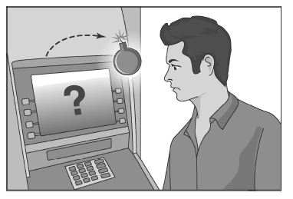
Logic Bomb
If (trigger_condition = true){
unleash bomb;
}
A logic bomb is a piece of code intentionally inserted into a software system that will set off a malicious function when specified conditions are met.
Notes:
A logic bomb is a piece of code intentionally inserted into a software system that will set off a malicious function when specified conditions are met. For example, a programmer may hide a piece of code that starts deleting files (such as a salary database trigger), should they ever be terminated from the company.
Software that is inherently malicious, such as viruses and worms, often contain logic bombs that execute a certain payload at a pre-defined time or when some other condition is met. This technique can be used by a virus or worm to gain momentum and spread before being noticed. Many viruses attack their host systems on specific dates, such as Friday the 13th or April Fool's Day. Trojans that activate on certain dates are often called "time bombs".
To be considered a logic bomb, the payload should be unwanted and unknown to the user of the software. As an example, trial programs with code that disables certain functionality after a set time are not normally regarded as logic bombs.

Slide 14
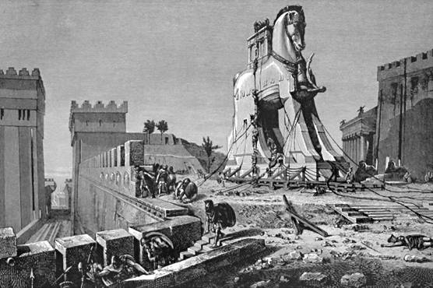
Trojan Horses
Notes:
Then, let’s talk about Trojan Horses.
Trojan.[ˈtrəudʒən]

Slide 15
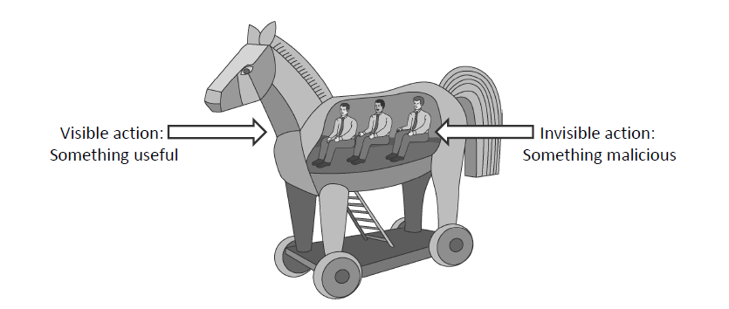
Trojan Horses
A Trojan horse (or Trojan) is a malware program that appears to perform some useful task, but which also does something with negative consequences (e.g., launches a keylogger).
Trojan horses can be installed as part of the payload of other malware but are often installed by a user or administrator, either deliberately or accidentally.
Notes:
trojan [‘trəudʒən]n. 勇士；特洛伊人；勤勉的人 adj. 特洛伊的；特洛伊人的
Deliberately [dɪ'lɪbərətli] adv. 故意地；谨慎地；慎重地

Slide 16

Trojan Horses
program with hidden side-effects
which is usually superficially attractive
eg game, s/w upgrade etc
when run performs some additional tasks
allows attacker to indirectly gain access they do not have directly
often used to propagate a virus/worm or install a backdoor
or simply to destroy data
Notes:
A Trojan horse is a useful, or apparently useful, program or command procedure (eg game, utility, s/w upgrade etc) containing hidden code that performs some unwanted or harmful function that an unauthorized user could not accomplish directly. Commonly used to make files readable, propagate a virus or worm or backdoor, or simply to destroy data.

Slide 17
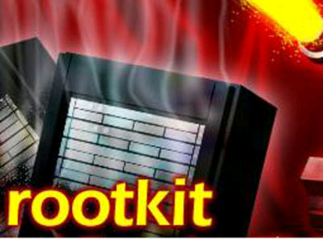
Rootkits
A rootkit is a component that uses stealth to maintain a persistent and undetectable presence on the machine.
---Symantec
Notes:
rootkit是攻击者用来隐藏自己的踪迹和保留root访问权限的工具。
stealth [stelθ] n. 秘密；秘密行动；鬼祟
A root kit is a component that uses stealth to maintain a persistent and undetectable presence on the machine. ——Symantec
A rootkit is software that enables continued privileged access to a computer while actively hiding its presence from administrators by subverting standard operating system functionality or other applications. The term rootkit is a concatenation [kənkætə‘neɪʃn] of "root" (the traditional name of the privileged account on Unix operating systems) and the word "kit" (which refers to the software components that implement the tool). The term "rootkit" has negative connotations through its association with malware.^{[1]}
Typically, an attacker installs a rootkit on a computer after first obtaining root-level access, either by exploiting a known vulnerability or by obtaining a password (either by cracking ['krækɪŋ] the encryption, or through social engineering). Once a rootkit is installed, it allows an attacker to mask the ongoing intrusion and maintain privileged access to the computer by circumventing [sɜːkəm'vent] normal authentication and authorization mechanisms. Although rootkits can serve a variety of ends, they have gained notoriety [nəʊtə'raɪɪtɪ] primarily as malware, hiding applications that appropriate computing resources or steal passwords without the knowledge of administrators and users of affected systems. Rootkits can target firmware, a hypervisor, the kernel, or—most commonly—user-mode applications.
Rootkit detection is difficult because a rootkit may be able to subvert the software that is intended to find it. Detection methods include using an alternate, trusted operating system; behavioral-based methods; signature scanning; difference scanning; and memory dump analysis. Removal can be complicated or practically impossible, especially in cases where the rootkit resides in the kernel; reinstallation of the operating system may be the only alternative.
concatenation [kənkætə‘neɪʃn] n. 串联，连结
cracking ['krækɪŋ] n. 破裂；分馏
circumvent [sɜːkəm'vent] vt. 包围；陷害；绕行
authorization [ɔːθəraɪ‘zeɪʃ(ə)n] n. 授权，认可；批准，委任
notoriety [nəʊtə'raɪɪtɪ] n. 恶名；声名狼藉；丑名
hypervisor [,haipə'vaizə] n. 超级监督者；管理程序
memory dump analysis 内存转储分析

Slide 18
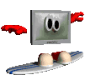
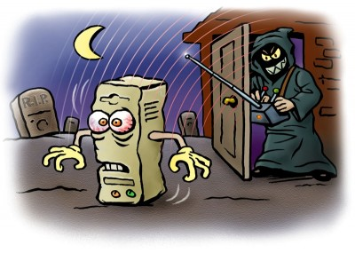
Botnets
Botnets are such networks that control vast networks of compromised computers, using them as nodes in a spam operation or stealing information from their owners.
Bot herder is the owner who centrally controlled the botnets.
Notes:
The earliest malware was developed for research purposes, but before long malware was being used to conduct destructive pranks and targeted attacks against individuals and organizations. With the widespread adoption of the Internet and the vast amounts of sensitive information stored on home computers, information theft and spam have become lucrative criminal ventures.
Botnets are such networks that control vast networks of compromised computers, using them as nodes in a spam operation or stealing information from their owners.
Bot herder is the owner who centrally controlled the botnets.

Slide 19
Malware Zombies
Malware can turn a computer in to a zombie, which is a machine that is controlled externally to perform malicious attacks, usually as a part of a botnet.
Botnet Controller (Bot herder)
Attack Commands
Botnet:
Attack Actions
Victim
Notes:
Malware can turn a computer in to a zombie, which is a machine that is controlled externally to perform malicious attacks, usually as a part of a botnet. The network can be centrally controlled by an owner known as a bot herder.

Slide 20
Privacy-Invasive Software
Privacy-Invasive Software -another category of malware.
Aim: user’s privacy or information that a user considers sensitive or valuable
The intent behind privacy-invasive software is usually commercial, rarely merely for the sake of curiosity or vandalism.
Two forms of privacy-invasive software:
- Adware
- Spyware
Notes:
The software invades a user’s computer to either operate in the background performing privacy-invasive actions against the user’s consent or to immediately gather sensitive or valuable information against the user’s wishes.
The intent behind privacy-invasive software is usually commercial. The agent who launched it could, for example, be interested in generating revenue from pop-up advertisements. He could alternatively be interested in stealing information about a user that he can resell to interested parties, or he may have a direct commercial interest in the privacy-invasive action the software is engaging in. In any case, the privacy violations performed by such malware are rarely merely for the sake of curiosity or vandalism.
Now, there are two forms of privacy-invasive: adware and spyware. In the following, we will introduce them in detail.

Slide 21
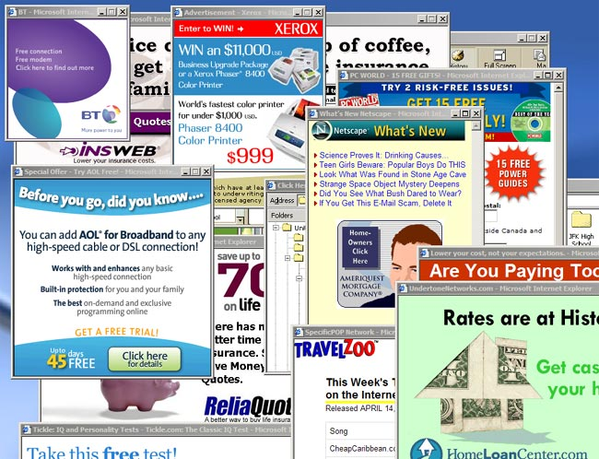
Adware
Adware, or advertising-supported software, is any software package which automatically plays, displays, or downloads advertisements to a computer.
Notes:
Adware, or advertising-supported software, is any software package which automatically plays, displays, or downloads advertisements to a computer. These advertisements can be in the form of a pop-up. The object of the Adware is to generate revenue for its author. Adware, by itself, is harmless; however, some adware may come with integrated spyware such as keyloggers and other privacy-invasive software.

Slide 22


Approximately 90% of all computers worldwide that use the Internet have been -----or currently are----- infected with spyware.
Notes:
Surprisingly enough, or you may not notice that, most of the computers in the world which are connected to the Internet have been or currently are infected with spyware.

Slide 23

What is ?
Spyware is a piece of software intended to monitor computer usage
This data can be collected anonymously for statistical purposes or with knowledge of whose usage they are tracking
Spyware comes in basically two flavors
Commercial Spyware
Subversive Spyware
SPYWARE
Notes:
Subversive，破坏性的，有敌意的

Slide 24
What does spyware do?
Installation of ‘keystroke logging’ program
Hijack internet browser / homepage
Track Internet-surfing habits
Hogs system’s memory, CPU cycles & Internet bandwidth
Creates its own files, cookies, DDLs, registry key…
Notes:
If you aren’t aware of spyware, it can do a lot of things in your computer, like install a “keystroke logging” program that allows a criminal to see everything you type on your keyboard including passwords and credit card numbers; hijack your Internet browser and changes its default home page and search engine or both; tracks your Internet-surfing habits and sends this information to hackers who can use it to commit identity theft, or to online marketers who will send you customized pop-up advertisements; hogs your system’s memory, CPU cycles, and Internet bandwidth; creates its own files, folders, cookies, DLLs, and registry keys.

Slide 25
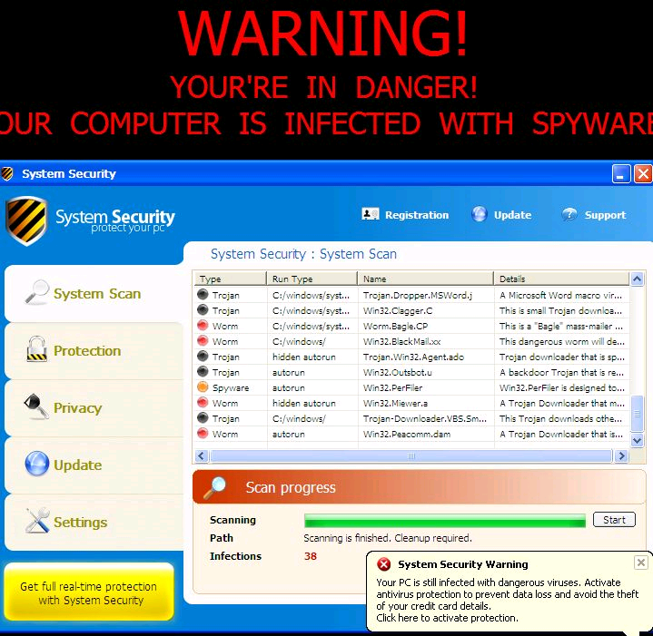
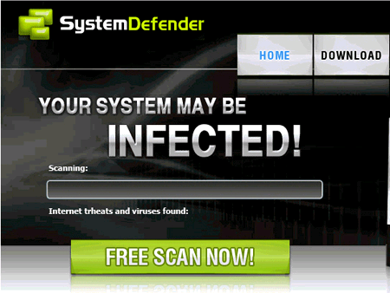
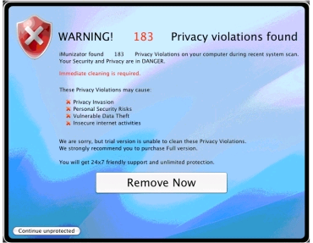
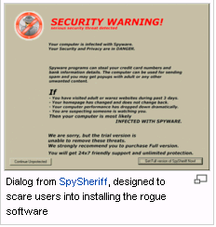
What is Scareware
Notes:
Scareware comprises several classes of scam software with malicious payloads, or of limited or no benefit, that are sold to consumers via certain unethical marketing practices. The selling approach uses social engineering to cause shock, anxiety, or the perception of a threat, generally directed at an unsuspecting user. Some forms of spyware and adware also use scareware tactics.
A tactic frequently used by criminals involves convincing users that a virus has infected their computer, then suggesting that they download (and pay for) fake antivirus software to remove it.^{[1]} Usually the virus is entirely fictional and the software is non-functional or malware itself.^{[2]} According to the Anti-Phishing Working Group, the number of scareware packages in circulation rose from 2,850 to 9,287 in the second half of 2008.^{[3]} In the first half of 2009, the APWG identified a 585% increase in scareware programs.^{[4]}
The "scareware" label can also apply to any application or virus (not necessarily sold as above) which pranks users with intent to cause anxiety or panic

Slide 26
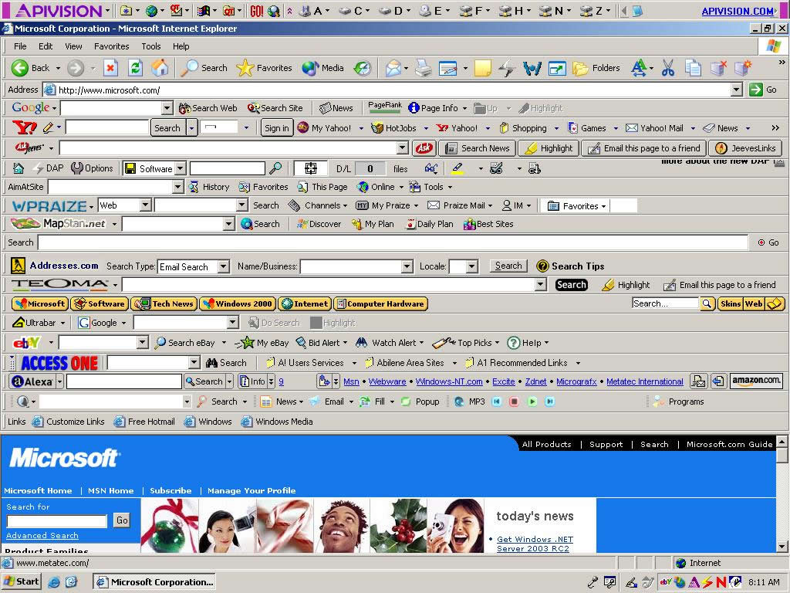
Browser Toolbar ...

Slide 27
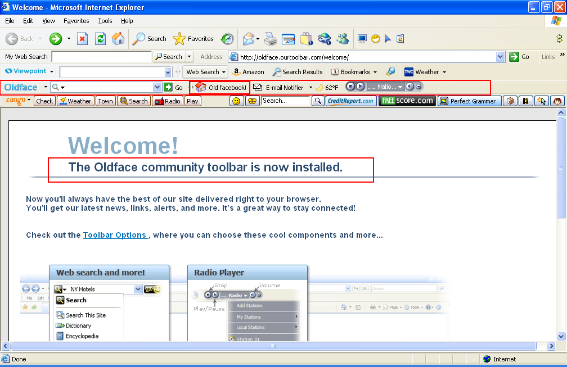
Toolbar again

Slide 28
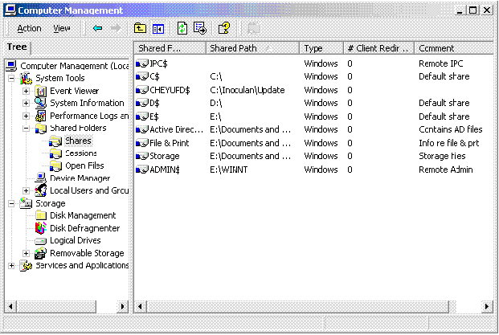
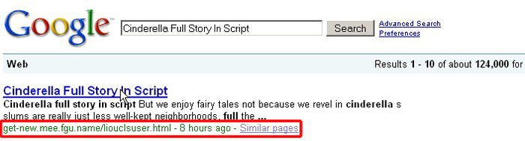
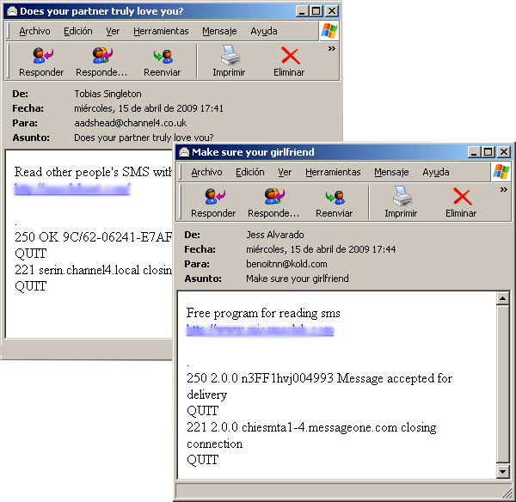
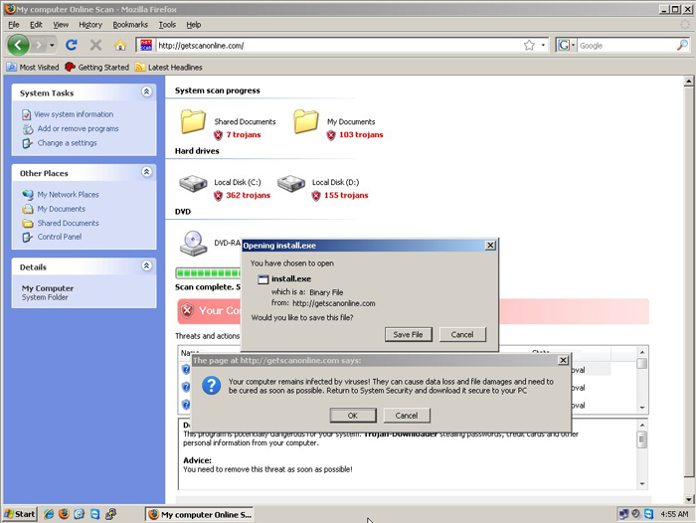
Shared folder
How do they propagate
Hijack you browser
Fake page !
Email propagation
Notes:
How do they propagate

Slide 29

Malware: Malicious Software(2)
History of computer Malware
Notes:
Today，we will continue to study the malicious software.

Slide 30

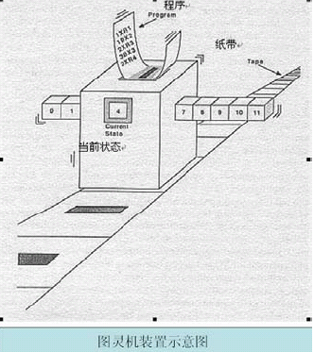
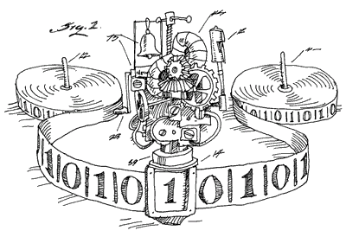
“论可计算数及其在判定问题中的应用”
(On computable numbers， with an application to the Entscheidungs problem)
Notes:
这个装置由下面几个部分组成：一个被划分成方格的无限长的纸带，一个读写头。（中间那个大盒子），内部状态（盒子上的方块，比如A,B,E,H），另外，还有一个程序对这个盒子进行控制。这个装置就是根据程序的命令以及它的内部状态进行磁带的读写、移动。
1934年图灵曾经发表的论文"On Computable Numbers with an Application to the Entscheidungs-problem"不可不提，在这篇论文中，图灵提出了通用机的概念，冯·诺依曼应该知道了这个思想，至少后来他是不是应用了这个思想却不得而知。
http://baike.baidu.com/view/1703697.html
1936年5月，图灵写出了表述他的最重要的数学成果的论文“论可计算数及其在判定问题中的应用”(On computable numbers，with an application to the Entscheidungsproblem)，该文于1937年在《伦敦数学会文集》(Proc．Loud．Math．Soc．)第42期上发表后，立即引起广泛的注意．文中，他分析了计算的过程，给出了理论上可计算任何“可计算序列”——某种0和1的序列——的“通用”计算机概念，并利用这一概念解决了D．希尔伯特(Hil-lbert)提出的一个著名的判定问题．1937年，图灵发表的另一篇文章“可计算性与λ可定义性”(Computability andλ-definability)则拓广了丘奇(Church)提出的“丘奇论点”，形成“丘奇-图灵论点”，对计算理论的严格化，对计算机科学的形成和发展都具有奠基性的意义．
图灵的基本思想是用机器来模拟人们用纸笔进行数学运算的过程，他把这样的过程看作下列两种简单的动作：
在纸上写上或擦除某个符号；
把注意力从纸的一个位置移动到另一个位置；
而在每个阶段，人要决定下一步的动作，依赖于 (a)此人当前所关注的纸上某个位置的符号和（b）此人当前思维的状态。
为了模拟人的这种运算过程，图灵构造出一台假想的机器，该机器由以下几个部分组成：
一条无限长的纸带TAPE。纸带被划分为一个接一个的小格子，每个格子上包含一个来自有限字母表的符号，字母表中有一个特殊的符号表示空白。纸带上的格子从左到右依此被编号为0, 1, 2, ...，纸带的右端可以无限伸展。
一个读写头HEAD。该读写头可以在纸带上左右移动，它能读出当前所指的格子上的符号，并能改变当前格子上的符号。
一套控制规则TABLE。它根据当前机器所处的状态以及当前读写头所指的格子上的符号来确定读写头下一步的动作，并改变状态寄存器的值，令机器进入一个新的状态。
一个状态寄存器。它用来保存图灵机当前所处的状态。图灵机的所有可能状态的数目是有限的，并且有一个特殊的状态，称为停机状态。参见停机问题。
注意这个机器的每一部分都是有限的，但它有一个潜在的无限长的纸带，因此这种机器只是一个理想的设备。图灵认为这样的一台机器就能模拟人类所能进行的任何计算过程。

Slide 31
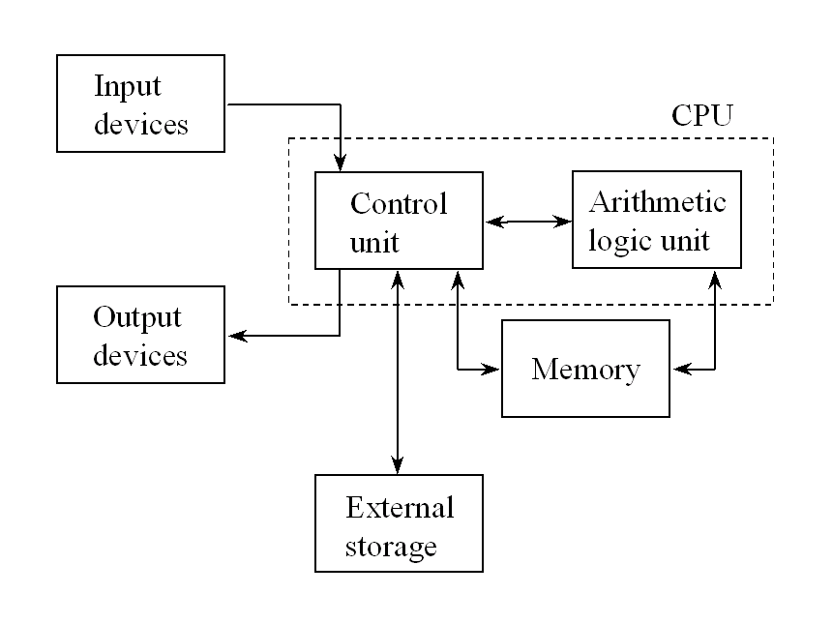
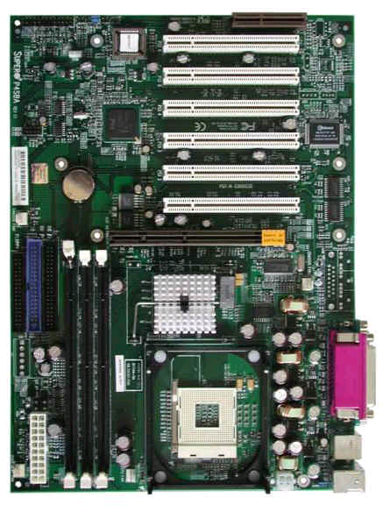
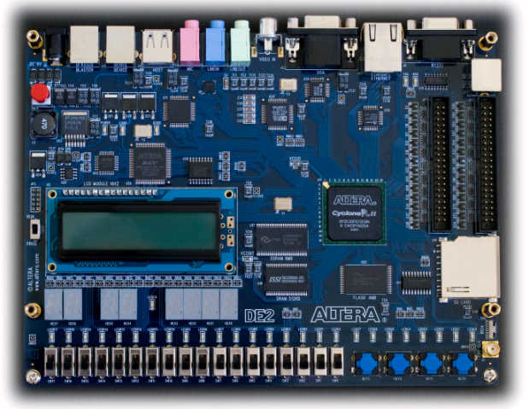
Computer architecture
Notes:
同样是在20世纪40年代，关于计算机的研制工作也在如火如荼地展开
冯·诺依曼为计算机的体系结构作了奠基性的工作，近60年以来，计算机的性能发生了翻天覆地的变化，但是计算机体系结构的一些基本的方面，仍然没有跳出冯·诺依曼提出的一些基本原则的范围
正是这些基本的原则，构成了以计算机病毒为主要代表的恶意代码的存在提供了系统的前提
最简单的来说 他的精髓贡献是2点：2进制思想与程序内存思想
回顾20世纪科学技术的辉煌发展时，不能不提及20世纪最杰出的数学家之一的冯·诺依曼．众所周知，1946年发明的电子计算机，大大促进了科学技术的进步，大大促进了社会生活的进步．鉴于冯·诺依曼在发明电子计算机中所起到关键性作用，他被西方人誉为"计算机之父"．而在经济学方面，他也有突破性成就，被誉为“博弈论之父”。在物理领域，冯·诺依曼在30年代撰写的《量子力学的数学基础》已经被证明对原子物理学的发展有极其重要的价值。在化学方面也有相当的造诣，曾获苏黎世高等技术学院化学系大学学位。与同为犹太人的哈耶克一样，他无愧是上世纪最伟大的全才之一。
约翰·冯·诺依曼
冯·诺依曼在数学的诸多领域都进行了开创性工作，并作出了重大贡献．在第二次世界大战前，他主要从事算子理论、集合论等方面的研究．1923年关于集合论中超限序数的论文，显示了冯·诺依曼处理集合论问题所特有的方式和风格．他把集会论加以公理化，他的公理化体系奠定了公理集合论的基础．他从公理出发，用代数方法导出了集合论中许多重要概念、基本运算、重要定理等．特别在1925年的一篇论文中，冯·诺依曼就指出了任何一种公理化系统中都存在着无法判定的命题．
1933年，冯·诺依曼解决了希尔伯特第5问题，即证明了局部欧几里得紧群是李群．1934年他又把紧群理论与波尔的殆周期函数理论统一起来．他还对一般拓扑群的结构有深刻的认识，弄清了它的代数结构和拓扑结构与实数是 一致的． 他对算子代数进行了开创性工作，并奠定了它的理论基础，从而建立了算子代数这门新的数学分支．这个分支在当代的有关数学文献中均称为冯·诺依曼代数．这是 有限维空间中矩阵代数的自然推广． 冯·诺依曼还创立了博弈论这一现代数学的又一重要分支． 1944年发表了奠基性的重要论文《博弈论与经济行为》．论文中包含博弈论的纯粹数学形式的阐述以及对于实际博弈应用的详细说明．文中还包含了诸如统计理论等教学思想．冯·诺依曼在格论、连续几何、理论物理、动力学、连续介质力学、气象计算、原子能和经济学等领域都作过重要的工作．
冯·诺依曼对人类的最大贡献是对计算机科学、计算机技术、数值分析和经济学中的博弈论的开拓性工作．
现在一般认为ENIAC机是世界第一台电子计算机，它是由美国科学家研制的，于1946年2月14日在费城开始运行．其实由汤米、费劳尔斯等英国科学家研制的"科洛萨斯"计算机比ENIAC机问世早两年多，于1944年1月10日在布莱奇利园区开始运行．ENIAC机证明电子真空技术可以大大地提高计算技术，不过，ENIAC机本身存在两大缺点：（1）没有存储器；（2）它用布线接板进行控制，甚至要搭接几天，计算速度也就被这一工作抵消了．ENIAC机研制组的莫克利和埃克特显然是感到了这一点，他们也想尽快着手研制另一台计算机，以便改进．
1944年，诺伊曼参加原子弹的 研制工作，该工作涉及到极为困难的计算。在对原子核反应过程的研究中，要对一个反应的传播做出“是”或“否”的回答。解决这一问题通常需要通过几十亿次的 数学运算和逻辑指令，尽管最终的数据并不要求十分精确，但所有的中间运算过程均不可缺少，且要尽可能保持准确。他所在的洛·斯阿拉莫斯实验室为此聘用了一 百多名女计算员，利用台式计算机从早到晚计算，还是远远不能满足需要。无穷无尽的数字和逻辑指令如同沙漠一样把人的智慧和精力吸尽。
被计算机所困扰的诺伊曼在一次极为偶然的机会中知道了ENIAC计算机的研制计划，从此他投身到计算机研制这一宏伟的事业中，建立了一生中最大的丰功伟绩。
1944年夏的一天，正在火车站 候车的诺伊曼巧遇戈尔斯坦，并同他进行了短暂的交谈。当时，戈尔斯坦是美国弹道实验室的军方负责人，他正参与ENIAC计算机的研制工作。在交谈在，戈尔 斯坦告诉了诺伊曼有关ENIAC的研制情况。具有远见卓识的诺伊曼为这一研制计划所吸引，他意识到了这项工作的深远意义。
冯·诺依曼由ENIAC机研制组的戈尔德斯廷中尉介绍参加ENIAC机研制小组后，便带领这批富有创新精神的年轻科技人员，向着更高的目标进军．1945年，他们在共同讨论的基础上，发表了一个全新的"存储程序通用电子计算机方案"--EDVAC（Electronic Discrete Variable AutomaticCompUter的缩写）．在这过程中，冯·诺依曼显示出他雄厚的数理基础知识，充分发挥了他的顾问作用及探索问题和综合分析的能力。 诺伊曼以“关于EDVAC的报告草案”为题，起草了长达101页的总结报告。报告广泛而具体地介绍了制造电子计算机和程序设计的新思想。这份报告是计算机发展史上一个划时代的文献，它向世界宣告：电子计算机的时代开始了。
EDVAC方案明确奠定了新机器由五个部分组成，包括：运算器、逻辑控制装置、存储器、输入和输出设备，并描述了这五部分的职能和相互关系．报告中，诺伊曼对EDVAC中的两大设计思想作了进一步的论证，为计算机的设计树立了一座里程碑。
设计思想之一是二进制，他根据电子元件双稳工作的特点，建议在电子计算机中采用二进制。报告提到了二进制的优点，并预言，二进制的采用将大简化机器的逻辑线路。
现在使用的计算机，其基本工作原理是存储程序和程序控制，它是由世界著名数学家冯·诺依曼提出的。美籍匈牙利数学家冯·诺依曼被称为“计算机之父”。
实践证明了诺伊曼预言的正确性。如今，逻辑代数的应用已成为设计电子计算机的重要手段，在EDVAC中采用的主要逻辑线路也一直沿用着，只是对实现逻辑线路的工程方法和逻辑电路的分析方法作了改进。
程序内存是诺伊曼的另一杰作。通过对ENIAC的考察，诺伊曼敏锐地抓住了它的最大弱点－－没有真正的存储器。ENIAC只在20个暂存器，它的程序是外插型的，指令存储在计算机的其他电路中。这样，解题之前，必需先相好所需的全部指令，通过手工把相应的电路联通。这种准备工作要花几小时甚至几天时间，而计算本身只需几分钟。计算的高速与程序的手工存在着很大的矛盾。
针对这个问题，诺伊曼提出了程序内存的思想：把运算程序存在机器的存储器中，程序设计员只需要在存储器中寻找运算指令，机器就会自行计算，这样，就不必每个问题都重新编程，从而大大加快了运算进程。这一思想标志着自动运算的实现，标志着电子计算机的成熟，已成为电子计算机设计的基本原则。
1946年7，8月间，冯·诺依曼和戈尔德斯廷、勃克斯在EDVAC方案的基础上，为普林斯顿 大学高级研究所研制IAS计算机时，又提出了一个更加完善的设计报告《电子计算机逻辑设计初探》．以上两份既有理论又有具体设计的文件，首次在全世界掀起 了一股"计算机热"，它们的综合设计思想，便是著名的"冯·诺依曼机"，其中心就是有存储程序原则--指令和数据一起存储．这个概念被誉为'计算机发展史 上的一个里程碑"．它标志着电子计算机时代的真正开始，指导着以后的计算机设计．自然一切事物总是在发展着的，随着科学技术的进步，今天人们又认识到" 冯·诺依曼机"的不足，它妨碍着计算机速度的进一步提高，而提出了"非冯·诺依曼机"的设想．
冯·诺依曼还积极参与了推广应用计算机的工作，对如何编制程序及搞数值计算都作出了杰出的贡献． 冯·诺依曼于1937年获美国数学会的波策奖；1947年获美国总统的功勋奖章、美国海军优秀公民服务奖；1956年获美国总统的自由奖章和爱因斯坦纪念奖以及费米奖．
冯·诺依曼逝世后，未完成的手稿于1958年以《计算机与人脑》为名出版．他的主要著作收集在六卷《冯·诺依曼全集》中，1961年出版．
另外，冯·诺依曼40年代出版的著作《博弈论和经济行为》，使他在经济学和决策科学领域竖起了一块丰碑。他被经济学家公认为博弈论之父。当时年轻的约翰·纳什在普林斯顿求学期间开始研究发展这一领域，并在1994年凭借对博弈论的突出贡献获得了诺贝尔经济学奖。

Slide 32
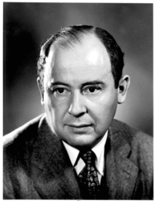
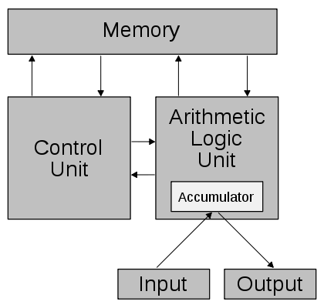
冯•诺依曼
Notes:
冯•诺依曼是第一个写出能进行完全自我复制程序的人，在他写出几年后就有人利用这种方法，制造出了病毒。早在1949年,冯•诺依曼(John Von Nermann),这位伟大的数学家和计算机科学家就在其《复杂机器的理论与结构》(Theory and Organization of Complicated Automata)的论文中首次提出了复杂机械的自动复制的理论,即程序能在内存中进行繁殖。在此之后,1957年在冯•诺依曼逝世之后,Yale大学出版社出版了他的遗著《计算机与人脑》(Comprter and Brain),书中又详细讨论了复制程序的理论。50年代后期Bell实验室和Xerox公司研究人工智能的专家开发出用于娱乐的Core War游戏程序。由于这种游戏引起了系统的瘫痪,最终Core War游戏程序被终止使用(从此,程序自我复制理论沉睡了20年)。60年代Conway设计出具有复制机制的"活的"程序。1983年程序复制理论被UNIX操作系统的创始人之一、获得A.M.Turing奖的Ken Thompson公之于众。1984年《科学美国人》出版,它详细讨论了Core War,同时包括有编写可自我复制的程序的信息。计算机病毒的研究在美国大学校园和计算机黑客(Harker)中得到了进一步发展。1983年,Fred Cohen在作其博士论文时,开始着手研究计算机病毒传染性实现的可能性以及计算机病毒的预防问题。同年11月Fred Cohen在美国一个"计算机安全每周会议上"将这种能够寄生于其他程序之上且具有自身复制能力的程序实现的可能性问题出来,Len Adleman将其定名为计算机病毒。Fred Cohen于1984年全美计算机安全会议上争得同意又作了计算机病毒的传染实验,通过反复的实验验证了计算机病毒的传染性和真实存在性,从此这种能够自身复制自身并以其他程序为宿主的可执行的代码,冠以计算机病毒的名称为美国计算机安全界所了解。1987年Fred Cohen在计算机与安全的第一期上发表了《计算机病毒:理论与实践》的文章,从此,专门讨论计算机病毒的文章出现了。

Slide 33
冯·诺依曼体系结构(Von Neumann architecture)
指令
寄存器
指令计数器
寄存器
指令寄存器
寄存器
数据
运算器
Stored-program architecture
存储器
Notes:
指令存储
指令存储，是冯·诺依曼体系结构的核心特点，指令和数据在存储形态上没有分别，关键在程序的运行逻辑中你把存储的内容当作指令还是数据;
操作系统的引导，程序的编译，都离不开指令存储这一基本前提;
以计算机病毒为代表的恶意代码，也是利用了冯·诺依曼体系结构中关于指令存储的这个基本的前提.
Stored-program architecture
Stored-program computers were an advancement over the program-controlled computer
存储程序结构
Several developers of ENIAC, recognizing its flaws, came up with a far more flexible and elegant design, which came to be known as the "stored program architecture" or von Neumann architecture. This design was first formally described by John von Neumann in the paper First Draft of a Report on the EDVAC, distributed in 1945. A number of projects to develop computers based on the stored-program architecture commenced around this time, the first of these being completed in Great Britain. The first working prototype to be demonstrated was the Manchester Small-Scale Experimental Machine (SSEM or "Baby") in 1948. The Electronic Delay Storage Automatic Calculator (EDSAC), completed a year after the SSEM at Cambridge University, was the first practical, non-experimental implementation of the stored program design and was put to use immediately for research work at the university. Shortly thereafter, the machine originally described by von Neumann's paper—EDVAC—was completed but did not see full-time use for an additional two years.
Nearly all modern computers implement some form of the stored-program architecture, making it the single trait by which the word "computer" is now defined. While the technologies used in computers have changed dramatically since the first electronic, general-purpose computers of the 1940s, most still use the von Neumann architecture.
Beginning in the 1950s, Soviet scientists Sergei Sobolev and Nikolay Brusentsov conducted research on ternary computers, devices that operated on a base three numbering system of −1, 0, and 1 rather than the conventional binary numbering system upon which most computers are based. They designed the Setun, a functional ternary computer, at Moscow State University. The device was put into limited production in the Soviet Union, but supplanted by the more common binary architecture
《计算机病毒原理及防范技术》第8章计算机病毒理论模型_百度文库
- [ Translate this page ] 2010年8月26日 ... 实际上，Cohen的计算机病毒的形式化数学模型与Neumann的自我复制细胞自动机是十分相似的。 这个数学模型为解决计算机病毒问题奠定了重要的理论基础。
传统病毒定义是Fred Cohen博士1984年提出的，“计算机病毒是一种程序，它可以感染其它程序，感染的方式为在被感染程序中加入计算机病毒的一个副本，这个副本可能是在原病毒基础上演变过来的”。
Cohen提出计算机病毒的模型，证明只要延用现行的计算机体系，计算机病毒就存在“不可判定性”。
F·Cohen博士给出了如下简结的证明：假设能研究出一个检测程序D，对任何一个程序X。 D(X)=TRUE，X是病毒 D(X)=FALSE，X不是病毒 那么D无法判断以下程序V是不是病毒： PROCEDURE V： BEGIN： 1.IF NOT D(R) THEN GOTO 3； 2.GOTO 5； 3.传染一个可执行文件 4.若触发条件成立则执行破坏功能 5.正常功能； . . . END 这样，当D判断V是病毒时，V却不传染即V不是病毒，若D判断V是正常程序，V却执行病毒的功能，这与D的假设矛盾，即D是不可能编写出来的。 由于理论上的限制，不可能有一种完美无缺的，无条件病毒防治方法。
Cohen的《计算机病毒的理论与实践》发表以后，从理论上计算机病毒是不可判定的这一结论已经被大家所接受。 国内外计算机安全理论界对计算机病毒的理论研究目前已经基本停止。
受病毒在理论上就是不可判定的这一根本前提的制约，事实上，无论是启发式，亦或是虚拟机，都只能是一种工程学的努力，其成功的概率永远不可达到100％。
自动复制代码：计算机病毒的原理和定义 Cohen在1984年为计算机病毒提出了一个形式化的数学模型，这个模型使用图灵机。实际上，Cohen的计算机病毒的形式化数学模型与Neumann的自我复制细胞自动机是十分相似的。从Neumann的角度，我们可以说计算机病毒就是一个可以自我复制的细胞自动机。计算机病毒的数学模型对今天的研究来说是没有多少实际作用的，它只是对计算机病毒进行了十分通用的描述。然而，这个数学模型却为解决计算机病毒问题奠定了重要的理论基础。 Cohen对计算机病毒的非形式化定义是：“计算机病毒是一种计算机程序，它通过修改其他程序把它自己的一个拷贝或其演化的拷贝插入到其他程序中，从而感染它们。” 这个定义提出了计算机病毒的许多重要特性，例如病毒感染过程中有可能进行演化（通过改变其自身而成为演变体的能力）。然而，如果十分严格地应用这个定义，有时可能会产生一点误解。这决不是批评Cohen的开创性的模型。给出一个十分精确的定义是相当困难的，因为如今有太多类型的计算机病毒。例如，有些类型的计算机病毒—被称作伴生病毒（companion virus）—并没有必要改变其他程序的代码。它们并不是严格地遵循Cohen的定义，因为它们没有必要把自己插入到其他程序当中去。相反地，它们是用别的方法来利用程序的执行环境—操作系统的特性 —通过使用相同的名字，并在执行路径中将其放在“受害”程序的前面。如果防病毒程序的作者严格运用Cohen定义的话，他可能写出一种阻止病毒恶意操作（即修改其他程序）的“行为阻断”（behavior-blocking）防毒程序，而这样的程序对付伴生病毒就会有问题。换句话说，如果这种阻断程序只寻找对其他程序代码做不必要的修改的病毒，那么它是无法发现伴生病毒的。 注释Cohen在数学上的形式化定义中确实包含了伴生病毒；只是用一句话的文字来解释这样一个定义存在一定的问题，只用一句话给出计算机病毒的定义的确是十分困难的。 完整性检查程序基于以下事实：一个程序的代码在任何时候都是固定不变的。这种程序依靠一个数据库（事先建立的），假定数据库记录了机器上程序的“干净”状态。完整性检查程序是Cohen最喜欢的防御病毒的方法，在90年代早期我也很喜欢这种方法。然而，很容易发现完整性检查程序对发现伴生病毒是有缺陷的，除非完整性检查程序同样对任何系统中新执行的程序都向用户报警。Cohen自己的系统正是这样做的。不幸的是，普通用户不会喜欢每次系统执行一个新的程序都会收到一个报警，但是Cohen的方法确实是可以使用的最安全的方法。Cohen博士的定义并不区分专门设计用来复制自己的程序（我们可以称其为“真正的病毒”）还是那些只是把复制自己作为次要功能的一般复制程序（例如，编译器）。 事实也正是这样，在这种情况下“行为阻断”程序通常也会报警。例如Norton Commander，一个十分流行的命令解释器，可以用来将用户自己的代码复制到其他硬盘或网络上的其他系统上去。这种操作有可能会跟自我复制代码相混淆，尤其是当某个文件夹中已经有某个程序以前的版本，我们为了更新而将旧的版本覆盖的时候。尽管这种“虚警”是很容易处理的，但毫无疑问终端用户会对这些虚警感到反感。 考虑到这种情况，对计算机病毒更准确的定义应该是：“计算机病毒是一种计算机程序，它递归地、明确地（explicitly）复制自己或其演化体。”（所谓“明确地”，是指把复制作为主要功能而不是次要功能。—译者注） 没有必要指明复制到底是怎样进行的，同样并不严格要求“感染”或者修改其他程序或是宿主程序。然而，大部分计算机病毒确实修改其他程序的代码来获得控制权。通过阻断这种行为，可以在相当大的程度上减少病毒在系统上的传播。 因此，总需要有一个宿主，一个操作系统，或者其他类型的程序执行环境，如解释程序，一段特殊的符号序列在其中扮演着病毒的角色，并且递归地进行自我复制。计算机病毒是一种自动化的程序，它们会把自己的拷贝传播到新的目标系统中去，而这当然不是用户所希望的。尽管有些特殊的病毒在它们感染其他机器时会用提示符向用户询问，比如“你想感染其他程序吗？（是／否？）”，但这并不能说明它们就不是病毒。通常，计算机病毒研究实验室里新来的研究人员有可能并不这么认为，他们会争辩说这种程序并不是计算机病毒。显然，他们错了！ 当我们试图把某个特殊的程序归类为计算机病毒的时候，我们需要考虑一个重要的问题：这个程序是否可以递归地、明确地进行自我复制。如果一个程序在进行自我复制的过程中需要任何帮助，那么就不能认为它是计算机病毒。这里所说的帮助可能包括修改此程序的环境（例如，手工修改内存或是硬盘中内容），或者—但愿不会如此—通过使用调试器（debugger）对潜伏的病毒进行“热修补（hot fix）”。相反，我们将不能执行的病毒归类为潜在病毒（intended virus）。 这里所讨论的拷贝并不一定是原始病毒的精确副本，如今的计算机病毒，特别是一种被称作变型病毒（metamorphic virus）的病毒（我们将会在第7章中讨论），它们可以重写其自身的代码，使得病毒中用于自我复制的代码序列在其“后代”中变得与其完全不同，但却可以发挥相同的或相似的功能
*************************************************************************************
尽管计算机技术自20世纪40年代第一部电子通用计算机诞生以来以来有了令人目眩的飞速发展，但是今天计算机仍然基本上采用的是存储程序结构，即冯·诺伊曼结构。这个结构实现了实用化的通用计算机。
存储程序结构间将一部计算机描述成四个主要部分：算术逻辑单元（ALU），控制电路，存储器，以及输入输出设备（I/O）。这些部件通过一组一组的排线连接（特别地，当一组线被用于多种不同意图的数据传输时又被称为总线），并且由一个时钟来驱动（当然某些其他事件也可能驱动控制电路）。
概念上讲，一部计算机的存储器可以被视为一组“细胞”单元。每一个“细胞”都有一个编号，称为地址；又都可以存储一个较小的定长信息。这个信息既可以是指令（告诉计算机去做什么），也可以是数据（指令的处理对象）。原则上，每一个“细胞”都是可以存储二者之任一的。
***************************************************************************
修改程式很可能是非常具伤害性的，无论无意或设计错误。在一个简单的储存程式型电脑上，一个设计不良的程式可能会伤害自己、其他程式甚或是操作系统，导致当机。缓冲区溢位就是一个典型例子。而创造或更改其他程式的能力也导致了恶意软件的出现。利用缓冲区溢位，一个恶意程式可以覆盖呼叫堆栈（Call stack）并覆写程式码，并且修改其他程式档案以造成连锁破坏。内存保护机制及其他形式的存取控制可以
保护意外或恶意的程式码更动。
***********************************************************************
The earliest computing machines had fixed programs. Some very simple computers still use this design, either for simplicity or training purposes. For example, a desk calculator (in principle) is a fixed program computer. It can do basic mathematics, but it cannot be used as a word processor or a gaming console. Changing the program of a fixed-program machine requires re-wiring, re-structuring, or re-designing the machine. The earliest computers were not so much "programmed" as they were "designed". "Reprogramming", when it was possible at all, was a
laborious process, starting with flowcharts and paper notes, followed by detailed engineering designs, and then the often-arduous process of physically re-wiring and re-building the machine. It could take three weeks to set up a program on ENIAC and get it working.^{[1]}
The idea of the stored-program computer changed all that: a computer that by design includes an instruction set and can store in memory a set of instructions (a program) that details the computation.
A stored-program design also allows for self-modifying code. One early motivation for such a facility was the need for a program to increment or otherwise modify the address portion of instructions, which had to be done manually in early designs. This became less important when index registers and indirect addressing became usual features of machine architecture. Self-modifying code has largely fallen out of favor, since it is usually hard to understand and debug, as well as being inefficient under modern processor pipelining and caching schemes.
On a large scale, the ability to treat instructions as data is what makes assemblers, compilers and other automated programming tools possible. One can "write programs which write programs".^{[2]} On a smaller scale, I/O-intensive machine instructions such as the BITBLT primitive used to modify images on a bitmap display, were once thought to be impossible to implement without custom hardware. It was shown later that these instructions could be implemented efficiently by "on the fly compilation" ("just-in-time compilation") technology, e.g., code-generating programs—one form of self-modifying code that has remained popular.
There are drawbacks to the von Neumann design. Aside from the von Neumann bottleneck described below, program modifications can be quite harmful, either by accident or design. In some simple stored-program computer designs, a malfunctioning program can damage itself, other programs, or the operating system, possibly leading to a computer crash. Memory protection and other forms of access control can usually protect against both accidental and malicious program modification.
1946 年Von Neumann 在“电子计算机逻辑设计的初步讨论”一文中，首次提出了存储程序概念（stored program concept ），这是冯. 诺依曼设计思想的核心。冯. 诺依曼结构中指令和数据是不加区别混合存储在同一存储器中的，程序执行时通过译码来识别指令和数据。这种思想在现代计算机中仍被广泛应用。与冯. 诺依曼结构混合存储思想相对应的是一种称为哈佛结构的设计思想，其指令和数据分开存储的，即指令和数据分别存储于不同的存储器中。这种设计思想广泛用于单片机的设计中。众所周知，计算机的工作体现为程序的执行，计算机功能的扩展在很大程度上体现为所存储程序的扩展。^{[1]} 冯. 诺依曼结构和哈佛结构的存储器设计思想各有优缺点，本文将就几个相关方面对两者进行分析和比较。

Slide 34
The History of Computer Viruses
Notes:
When did you listen the word of “computer viruses”? 2000? Or later. Actually, it have a long history of computer viruses. Now, let’s study it.

Slide 35
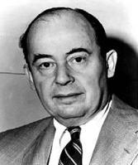
Hostory ——John Von Neumann(冯·诺依曼)
Theory and Organization of Complicated Automata
【复杂自动装置的理论及组织的进化,1949】
The roots of the modern computer virus go back to 1949, when computer pioneer John von Neumann presented a paper on the "Theory and Organization of Complicated Automata," in which he postulated that a computer program could reproduce.
Notes:
Theory and Organization of Complicated Automata
The roots of the modem computer virus go back to 1949, when computer pioneer John von Neumann presented a paper on the “Theory and Organization of Complicated Automata”, in which he postulated that a computer program could reproduce
早在1949年, 也就是第一部商用计算机出现的几年以前, 电子计算机的先驱者、美籍匈牙利科学家冯·诺伊曼(John Von Neumann)，就在他的一篇论文《复杂自动装置的理论及组织的进化》中, 勾勒出了病毒程序的蓝图。
这一思想在当时是非常超前的，同时代的绝大部份计算机专家都无法想象这种能够自我繁殖的程序是什么样子。只有少数几个科学家开始默默地研究冯·诺伊曼所提出的概念。
http://baike.baidu.com/view/54300.htm
1903年12月28日，在布达佩斯诞生了一位神童，这不仅给这个家庭带来了巨大的喜悦，也值得整个计算机界去纪念。正是他，开创了现代计算机理论，其体系结构沿用至今，而且他早在40年代就已预见到计算机建模和仿真技术对当代计算机将产生的意义深远的影响。他，就是约翰·冯·诺依曼（John Von Neumann）。
约翰·冯·诺依曼 （ John Von Neumann，1903－1957），美藉匈牙利人，1903年12月28日生于匈牙利的布达佩斯，父亲是一个银行家，家境富裕，十分注意对孩子的教育．冯·诺依曼从小聪颖过人，兴趣广泛，读书过目不忘．据说他6岁时就能用古希腊语同父亲闲谈，一生掌握了七种语言．最擅德语，可在他用德语思考种种设想时，又能以阅读的速度译成英语．他对读过的书籍和论文．能很快一句不差地将内容复述出来，而且若干年之后，仍可如此．1911年一1921年，冯·诺依曼在布达佩斯的卢瑟伦中学读书期间，就崭露头角而深受老师的器重．在费克特老师的个别指导下并合作发表了第一篇数学论文，此时冯·诺依曼还不到18岁．1921年一1923年在苏黎世大学学习．很快又在1926年以优异的成绩获得了布达佩斯大学数学博士学位，此时冯·诺依曼年仅22岁．1927年一1929年冯·诺依曼相继在柏林大学和汉堡大学担任数学讲师。1930年接受了普林斯顿大学客座教授的职位，西渡美国．1931年他成为美国普林斯顿大学的第一批终身教授，那时，他还不到30岁。1933年转到该校的高级研究所，成为最初六位教授之一，并在那里工作了一生． 冯·诺依曼是普林斯顿大学、宾夕法尼亚大学、哈佛大学、伊斯坦堡大学、马里兰大学、哥伦比亚大学和慕尼黑高等技术学院等校的荣誉博士．他是美国国家科学院、秘鲁国立自然科学院和意大利国立林且学院等院的院士． 1954年他任美国原子能委员会委员；1951年至1953年任美国数学会主席．
1954年夏，冯·诺依曼被发现患有癌症，1957年2月8日，在华盛顿去世，终年54岁．
最简单的来说 他的精髓贡献是2点：2进制思想与程序内存思想

Slide 36
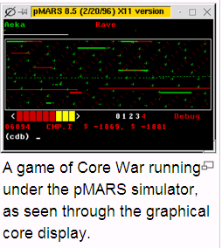
History—Core War
Bell Labs employees (Victor A. Vyssotsky, Robert T.Morris and M. Douglas McIlroy) gave life to von Neumann's theory in the 1960s in a game they called "Core Wars.“
In this game, two programmers would unleash software "organisms" and watch as they vied for control of the computer. You can read about Core Wars in the May 1984 issue of Scientific American.
http://www.codinghorror.com/blog/2008/04/core-war-two-programs-enter-one-program-leaves.html
Notes:
vied [vaɪd]争夺某事物
Bell Labs employees (Victor A. Vyssotsky, Robert T.Morris and M. Douglas McIlroy) gave life to von Neumann's theory in the 1960s in a game they called "Core Wars.“
In this game, two programmers would unleash software "organisms" and watch as they vied for control of the computer. You can read about Core Wars in the May 1984 issue of Scientific American.
The game consisted of a program called the umpire and a designated section of the computer's memory known as the arena, into which two or more small programs, written by the players, were loaded. The programs were written in 7090 machine code, and could call a number of functions provided by the umpire in order to probe other locations within the arena, kill opposing programs, and claim vacant memory for copies of themselves.
The game ended after a set amount of time, or when copies of only one program remained alive. The player who wrote the last surviving program was declared winner.
磁芯/核心大战(core war)的自我复制是在一个特定的受控环境下进行，但是基本行为与现在的病毒已经非常相近。游戏的玩法如下：双方各编一组再生程序，输入同一部电脑中，这两套程序在电脑的记忆系统内互相追杀,有时它们会设下一些关卡，有时会停下来修理(重新写)被对方破坏的几行指令，当它被困时，也可以把自己复制一次，逃离险境。

Slide 37
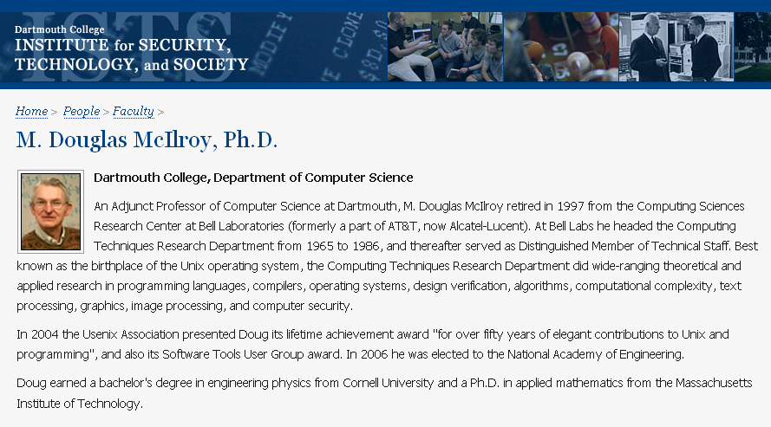
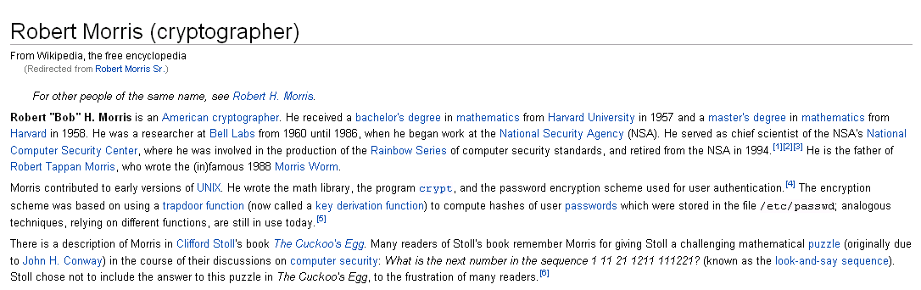
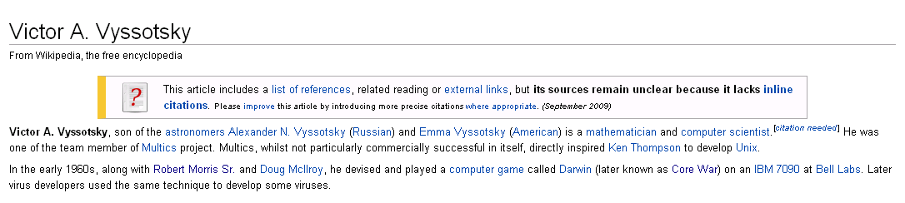

Slide 38

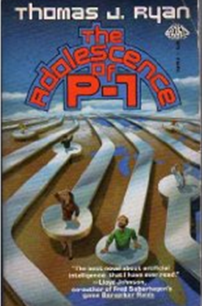
History—science-fiction
Two science-fiction books in the 1970s helped to promote the concept of a replicating program.
John Brunner's Shockwave Rider and Thomas Ryan's Adolescence of P-1 depicted worlds where a piece of software could transfer itself from one computer to another without detection.
Notes:
Two science-fiction books in the 1970s helped to promote the concept of a replicating program. John Brunner's Shockwave Rider and Thomas Ryan's Adolescence of P-1 depicted worlds where a piece of software could transfer itself from one computer to another without detection
The Shockwave Rider is a science fiction novel by John Brunner, originally published in 1975. It is notable for its hero's use of computer hacking skills to escape pursuit in a dystopian future, and for the coining of the word "worm" to describe a program that propagates itself through a computer network. It also introduces the concept of a Delphi pool, perhaps derived from the RAND Corporations' Delphi method - a futures market on world events which bears close resemblance to DARPA's controversial and cancelled Policy Analysis Market.
The Adolescence of P-1 features a hacker who creates an artificial intelligence named P-1, which goes rogue and takes over computers in its desire to survive and seek out its creator. The book questions the value of human life, and what it means to be human. It is one of the first fictional depictions of the nature of a computer virus and how it can spread through a computer system, although predated by John Brunner's The Shockwave Rider.
1975年，美国科普作家约翰·布鲁勒尔(John Brunner)写了一本名为《震荡波骑士》(Shock Wave Rider)的书，该书第一次描写了在信息社会中，计算机作为正义和邪恶双方斗争的工具的故事，成为当年最佳畅销书之一。
1977年夏天，托马斯·捷·瑞安(Thomas.J.Ryan)的科幻小说《P-1的春天》(The Adolescence of P-1)成为美国的畅销书，作者在这本书中描写了一种可以在计算机中互相传染的病毒，病毒最后控制了7,000台计算机，造成了一场灾难

Slide 39
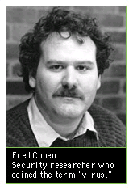
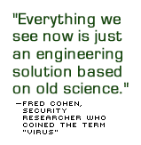
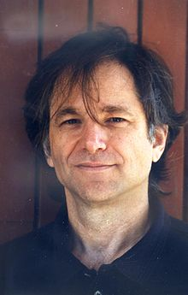
History ——The scientist break the ice
Fred Cohen presented the first rigorous mathematical definition for a computer virus in his 1986 Ph.D. thesis. Cohen coined the term "virus" at this point and is considered the father of what we know today as a computer virus. He sums it up in one sentence as "a program that can infect other programs by modifying them to include a, possibly evolved, version of itself."
A program that can 'infect' other programs by modifying them to include a possibly evolved copy of itself
--- Fred Cohen
Len Adleman
Notes:
Cohen[ˈkəuin] had an inkling of much of the future when he first thought up the idea in November 1983 as a University of Southern California graduate student. During a weekly seminar on computer security, he conceived of a program that could infect other systems with copies of itself.
"All at once, a light bulb came on, and I said, 'Aha!'" Cohen recalled. "Within a few seconds, I knew how to write the program and that it would work."
His adviser at the time, Len Adleman--well known as a creator of public-key encryption and the "A" in a popular form of the security technology known as RSA (Rivest, Shamir & Adleman)--suggested that the programs were the digital analogy of viruses. The name stuck.
Read more: http://news.cnet.com/A-20-year-plague/2009-7349_3-5111410.html#ixzz1LYl0PLhg
rederick B. Cohen (* 1957,) is an American computer scientist and best known as the inventor of computer virus defense techniques.
In 1983, while a student at the University of Southern California's School of Engineering (currently the Viterbi School of Engineering), he wrote a program for a parasitic application that seized control of computer operations, one of the first computer viruses, in Leonard Adleman’s class.
One of the few solid theoretical results in the study of computer viruses is Cohen's 1987 demonstration that there is no algorithm that can perfectly detect all possible viruses.^{[1]}
Cohen also believed there are positive viruses and he had created one called the compression virus which spreading would infect all executable files on a computer, not to destroy, but to make them smaller.^{[2]}
He has many other works related to computer viruses.
http://en.wikipedia.org/wiki/Fred_Cohen
1991, Trends In Computer Virus Research
1991, A Case for Benevolent Viruses
1991, The Computer Security Encyclopedia - Computer Viruses
1992, A Formal Definition of Computer Worms and Some Related Results
1989, Models of Practical Defenses Against Computer Viruses
1988, On the Implications of Computer Viruses and Methods of Defense
1984, Computer Viruses - Theory and Experiments

Slide 40
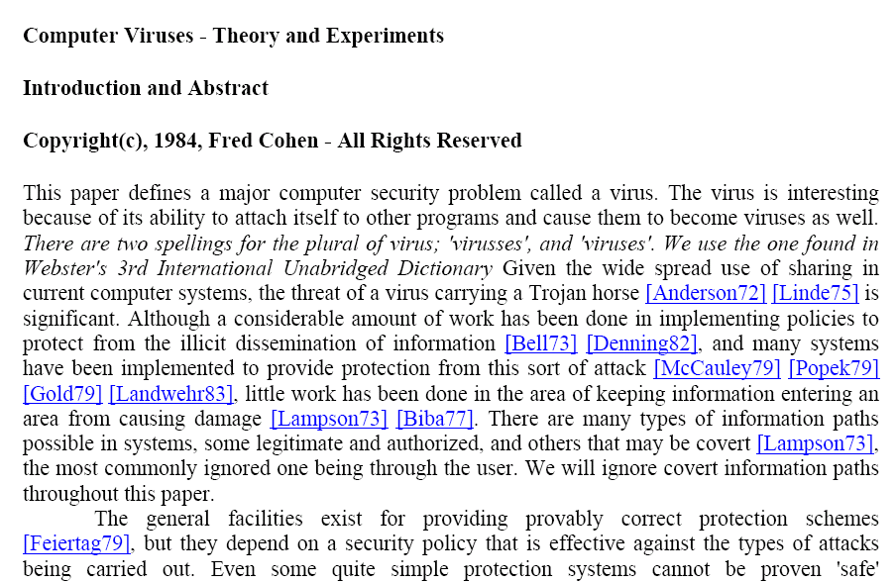
A program that can 'infect' other programs by modifying them to include a possibly evolved copy of itself--- Fred Cohen
Notes:
病毒理论方面的经典文章 收藏
Fred Cohen ____________________________________________________________________________________ Computational Aspects of Computer Viruses，下载 本文证明了“判断任何一个计算机程序中是否包含病毒是一个不可判定的问题”。这是一篇引用率很高的经典文章 Computer Viruses - Theory and Experiments，下载 本文开创性地给出了计算机病毒的基础理论及其相关结论。 A Formal Definition of Computer Worms and Some Related Results，下载 本文给出了计算机蠕虫的形式化定义，并基于此定义证明了蠕虫的相关属性等一系列结论。 Models of Practical Defenses Against Computer Viruses，下载 本文描述了计算机病毒防御技术的形式化模型。 Reply to `Comment on "A Framework for Modelling Trojans and Computer Virus Infection"' by E. Mäkinen，下载 本文针对现代操作系统完善了Computational Aspects of Computer Viruses中的形式化定义与模型。 Leonard Adleman ____________________________________________________________________________________ An Abstract Theory of Computer Viruses In recent years the detection of computer viruses has become common place. It appears that for the most part these viruses have been 'benign' or only mildly destructive. However, whether or not computer viruses have the potential t o cause major and prolonged disruptions of computing environments is an open question. Such basic questions as: How hard is it to detect programs infected by computer viruses? Can infected programs be 'disinfected'? What forms of protection exist? How destructive can computer viruses be? have been at most partially addressed [Col][Co2]'.Indeed a generally accepted definition of computer virus has yet to emerge. For these reasons, a rigorous study of computer viruses seems appropriate. Jan Bergstra, Alban Ponse ____________________________________________________________________________________ A Bypass of Cohen's Impossibility Result Detecting illegal resource access in the setting of network communication or grid computing is similar to the problem of virus detection as put forward by Fred Cohen in 1984. We disucuss Cohen's impossibility result on virus detection, and introduce "risk assessment of security hazards", a notion that is decidable for a large class of program behaviors. Guillaume Bonfante, Matthieu Kaczmarek, Jean-Yves Mario ____________________________________________________________________________________ Toward an abstract computer virology We are concerned with theoretical aspects of computer viruses. For this, we suggest a new definition of viruses which is clearly based on the iteration theorem and above all on Kleene's recursion theorem. We show that we capture in a natural way previous definitions, and in particular the one of Adleman. We establish generic constructions in order to construct viruses, and we illustrate them by various examples. We discuss about the relationship between information theory and virus and we propose a defense against some kind of viral propagation. Lastly, we show that virus detection is ∏02-complete. However, since we are able to deal with system vulnerability, we exhibit another defense based on controlling system access. David Chess, Steve White ____________________________________________________________________________________ An Undetectable Computer Virus One of the few solid theoretical results in the study of computer viruses is Cohen's 1987 demonstration that there is no algorithm that can perfectly detect all possible viruses [1]. This brief paper adds to the bad news, by pointing out that there are computer viruses which no algorithm can detect, even under a somewhat more liberal definition of detection. We also comment on the senses of "detect" used in these results, and note that the immediate impact of these results on computer virus detection in the real world is small. William Dowling ____________________________________________________________________________________ There Are No Safe Virus Tests This note gives a proof that no program can both test its input for the presence of a virus and simultaneously be guaranteed not to spread a virus itself. Eric Filiol, Marko Helenius, Stefano Zanero ____________________________________________________________________________________ Open problems in computer virology In this article, we briefly review some of the most important open problems in computer virology, in three different areas: theoretical computer virology, virus propagation modeling and antiviral techniques. For each area, we briefly describe the open problems, we review the state of the art, and propose promising research directions. Winfried Gleissner ____________________________________________________________________________________ A Mathematical Theory for the Spread of Computer Viruses A model is introduced to treat the spread of computer viruses mathematically. A recurrence formula is given which allows a closed expression to be derived for the probability that, starting from an initial state, a given viral state will be reached after executing exactly k programs. In some special cases this recurrence formula can be used for numeric computations, It is shown that the infection process does not stop before all programs are infected, which are visible for any infected program in the initial state. Kimmo Kauranen, Erkki Makinen ____________________________________________________________________________________ A note on Cohen's formal model for computer viruses This note discusses the formal model for computer viruses presented by Fred Cohen. We propose some refinements for the model. Especially, we define a computer virus to be a description of a Turing machine capable of writing a description of another Turing machine to the tape of a universal Turing machine. Arun Lakhotia, Prabhat Singh ____________________________________________________________________________________ Challenges in getting 'formal' with viruses Is it a virus, a worm, a Trojan, or a backdoor? Answering this question correctly for any arbitrary program is known to be an undecidable problem. That is, it is impossible to write a computer program that will identify correctly whether an arbitrary program is a virus, a worm, etc. - no matter how much computing power is thrown at the problem. Ferenc Leitold ____________________________________________________________________________________ Mathematical Model of Computer Viruses In real computers the operating system organizes the connection between the unique programs. In most operating systems a program can modify other program and/or data files. There are some special programs which utilize this facility of the operating system, for example the computer viruses. For the analysis of programs which modify other programs it is necessary to define a new computation model. The new mathematical model - called Random Access Stored Program Machine with Attached Background Storage (RASPM with ABS) - is introduced in this paper. The other required tool is a suitable model for the operating system. This new model is also introduced using mathematical methods. Reductions of the general virus detection problem Theoretically it is impossible to generate a program which can solve the general virus detection problem. This theorem has been proved in different ways in the literature. Since the general virus detection problem is not solvable, we have to reduce the problem: we can deal "only" with a subset of viruses. For example, we can limit the storage space of viruses or we can limit the execution time of viruses. Theoretically in these cases it can be proved that there is an algorithm for the virus detection problem. On the other hand, we can reduce the general virus detection problem if we deal with the known viruses only. In this paper, I would like to examine the virus detection problem, the possible reductions of the virus detection problem and, of course, I would like to highlight the usability of the virus detection algorithms in the practice too. Erkki Makinen ____________________________________________________________________________________ Comment on 'A Framework for Modelling Trojans and Computer Virus Infection' We (re-)introduce a Turing machine model for computer viruses. Despite the recent criticism of Turing machine models, they enjoy important advantages: their well-known notation and rich theory make them easy to understand and to elaborate. For many natural problems concerning computer viruses, e.g. for various decidability problems, Turing machine models provide a suitable platform of research. Diomidis Spinellis ____________________________________________________________________________________ Reliable Identification of Bounded-length Viruses is NP-complete A virus is a program that replicates itself by copying its code into other files. A common virus protection mechanism involves scanning files to detect code patterns of known viruses. We prove that the problem of reliably identifying a bounded-length mutating virus is NP-complete by showing that a virus detector for a certain virus strain can be used to solve the satisfiability problem. The implication of this result is that virus identification methods will be facing increasing strain as virus mutation and hosting strategies mature, and that different protection methods should be developed and employed. Harold Thimbleby, Stuart Anderson, Paul Cairns ____________________________________________________________________________________ A framework for modelling trojans and computer virus infection It is not possible to view a computer operating in the real world, including the possibility of Trojan Horse programs and computer viruses, as simply a finite realisation of a Turing Machine. We consider the actions of Trojan Horses and viruses in real computer systems and suggest a minimal framework for an adequate formal understanding of the phenomena. Some conventional approaches, including biological metaphors, are shown to be inadequate; some suggestions are made towards constructing virally-resistant systems. Matt Webster ____________________________________________________________________________________ Algebraic Specification of Computer Viruses and Their Environments This paper introduces an approach to formal specification of computer viruses and their environments through the development of algebraic specifications using Gurevich's Abstract State Machines (ASMs) and Goguen's OBJ. Distributed ASMs are used to develop a model of an abstract computer virus, which through a process of refinement is converted into models of different virus types. Further refinement has resulted in an executable specification, written in the Abstract State Machine Language, AsmL. The models strengthen the thesis that any algorithm can be modelled at a natural abstraction level using an Abstract State Machine. The ASM models combined with the AsmL executable specification provide a complementary theoretical and experimental framework for proofs and experiments on computer viruses and their environments, as well as a useful means of classification of different computer viruses types. Next we look at a different approach to computer virus analysis using OBJ, which is used to specify computer viruses written in an ad hoc programming language, SPL. The OBJ specification is shown to be useful for the detection of a virus type that is particularly difficult to detect - the metamorphic computer virus (MCV). Finally, the usefulness of the two specifications for reasoning about computer viruses is discussed and in this regard the two formalisms are compared. Sung Yang ____________________________________________________________________________________ Movement of Viruses Computer virus (computer organism) movement may be one of the most important phenomena of computer viruses, but there was almost no study and no interest on this issue. So this subject is very much unknown, and especially about the self-movement. Zhihong Zuo, Mingtian Zhou ____________________________________________________________________________________ Some Further Theoretical Results about Computer Viruses In this paper we give some general definitions of computer viruses which comply with our common understanding of computer viruses. Based on these definitions, we prove theoretically that there may exist some special kinds of computer viruses that have not been found in the real world yet. Furthermore, we prove that the set of computer viruses with the same kernel is ∏2-complete. In general the set of computer viruses is Σ3-complete. Zhihong Zuo, Mingtian Zhou, Qing-xin Zhu ____________________________________________________________________________________ On the Time Complexity of Computer Viruses Computer viruses can disable computer systems not only by destroying data or modifying a system's configuration, but also by consuming most of the computing resources such as CPU time and storage. The latter effects are related to the computational complexity of computer viruses. In this correspondence, we investigate some issues concerning the time complexity of computer viruses, and prove some known experimental results mathematically. We prove that there exist computer viruses with arbitrarily long running time, not only in the infecting procedure but in the executing procedure. Moreover, we prove that there are computer viruses with arbitrarily large time complexity in the detecting procedure, and there are undecidable computer viruses that have no "minimal" detecting procedure.

Slide 41
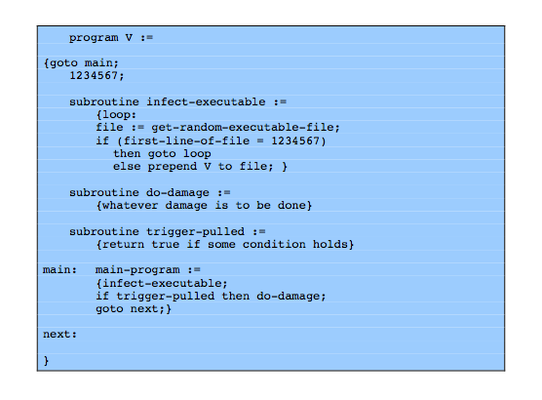
Virus Structure
Notes:
A very general depiction of virus structure is shown in the picture. In this case, the virus code, V, is prepended to infected programs, and it is assumed that the entry point to the program, when invoked, is the first line of the program. An infected program begins with the virus code and works as follows. The first line of code is a jump to the main virus program. The second line is a special marker that is used by the virus to determine whether or not a potential victim program has already been infected with this virus. When the program is invoked, control is immediately transferred to the main virus program. The virus program first seeks out uninfected executable files and infects them. Next, the virus may perform some action, usually detrimental to the system. This action could be performed every time the program is invoked, or it could be a logic bomb that triggers only under certain conditions. Finally, the virus transfers control to the original program. If the infection phase of the program is reasonably rapid, a user is unlikely to notice any difference between the execution of an infected and uninfected program.

Slide 42



self-reproducing programs （程序指向自身）
Ken Thompson，Turing Award Lecture：
Reflections on Trusting Trust. Commun. ACM 27(8): 761-763(1984)
to write a source program that, when compiled and executed, will produce as output an exact copy of its source. 【“写一个C程序，这个程序能把自己的源代码一字不差地打印出来，前提条件是不许读文件。”】
Notes:
1983年 。 第十八位图灵奖(1983年)获得者
程序指向自身：MIT博士生作业
题目是这样的：“写一个C程序，这个程序能把自己的源代码一字不差地打印出来，前提条件是不许读文件。”
后来，这个题目被公布到曙光BBS上，当时清华大学电子工程系的一个刚入学的硕士研究生（chenming）不久就把这道题目做了出来。

Slide 43
Computational aspects of computer viruses
Computational aspects of computer viruses。 Fred Cohen，Computers & Security，Volume 8, Issue 4, June 1989, Pages 297-298.
Theorem. It is undecidable whether an arbitrary program contains a computer virus.
【定理：任意一个程序是否包含病毒是不可判定的】
Notes:
In computability theory and computational complexity theory, an undecidable problem is a decision problem for which it is impossible to construct a single algorithm that always leads to a correct yes-or-no answer.
A decision problem is any arbitrary yes-or-no question on an infinite set of inputs. Because of this, it is traditional to define the decision problem equivalently as the set of inputs for which the problem returns yes. These inputs can be natural numbers, but also other values of some other kind, such as strings of a formal language. Using some encoding, such as a Gödel numbering, the strings can be encoded as natural numbers. Thus, a decision problem informally phrased in terms of a formal language is also equivalent to a set of natural numbers. To keep the formal definition simple, it is phrased in terms of subsets of the natural numbers.
Formally, a decision problem is a subset of the natural numbers. The corresponding informal problem is that of deciding whether a given number is in the set. A decision problem A is called decidable or effectively solvable if A is a recursive set. A problem is called partially decidable, semidecidable, solvable, or provable if A is a recursively enumerable set. Partially decidable problems and any other problems that are not decidable are called undecidable.
Cohen [207] asked if a single algorithm could detect computer viruses precisely. He demonstrated that the
virus detection problem, like the safety problem (see Theorem 3–2), is undecidable.
Theorem 22–1. [207] It is undecidable whether an arbitrary program contains a computer
virus.
Author: Fred Cohen
Computers & Security
Volume 8, Issue 4, June 1989, Pages 297-298

Slide 44


“An abstract theory of computer viruses”
An abstract theory of computer viruses.
Advances in Cryptology — CRYPTO’ 88
Lecture Notes in Computer Science, 1990, Volume 403/1990, 354-374.
Theorem. It is undecidable whether an arbitrary program contains malicious logic.
【定理：要判断任意程序是否包含恶意逻辑是不可判定的】
Notes:
An abstract theory of computer viruses
Advances in Cryptology — CRYPTO’ 88
Lecture Notes in Computer Science, 1990, Volume 403/1990, 354-374

Slide 45

History ——Worm(蠕虫染指互联网)
The Morris worm or Internet worm of November 2, 1988 was one of the first computer worms distributed via the Internet. It is considered the first worm and was certainly the first to gain significant mainstream media attention. It also resulted in the first conviction in the US under the 1986 Computer Fraud and Abuse Act. It was written by a student at Cornell University, Robert Tappan Morris, and launched on November 2, 1988 from MIT.
Notes:
1988年，莫里斯制作并传播了世界上第一个蠕虫病毒，通过当时的Internet大规模传播，染指了当时数万台联网主机的十分之一，造成了巨大的破坏
在此之后，如同打开的潘多拉的盒子，各种计算机病毒层出不穷
波士顿科学博物馆保存的存有莫里斯蠕虫源代码的磁盘
1988 年 11 月 2 日，美国六千多台计算机被病毒感染，造成 INTERNET不能正常运行。这是一次非常典型的计算机病毒入侵计算机网络的事件，迫使美国政府立即作出反应，国防部成立了计算机应急行动小组。这次事件中遭受攻击的包括 5 个计算机中心和 12 个地区结点，连接着政府、大学、研究所和拥有政府合同的 250,000 台计算机。这次病毒事件，计算机系统直接经济损失达 9600 万美元。这个病毒程序设计者是罗伯特·莫里斯 (ROBERT T.MORRIS)，当年 23 岁，是在康乃尔 (CORNELL) 大学攻读学位的研究生
On November 2, 1988, Robert Tappan Morris, a Cornell University computer science graduate student, unleashed what became known as the Morris worm, disrupting perhaps 10% of the computers then on the Internet and prompting the formation of the CERT Coordination Center and Phage mailing list. Morris himself became the first person tried and convicted under the 1986 Computer Fraud and Abuse Act.
Once infected, a machine would try to infect other machines in three ways:
Exploit a buffer overflow in the “finger” daemon
Use a back door left in the “sendmail” mail daemon
Try a “dictionary attack” against local users' passwords. If successful, log in as them, and spread to other machines they can access without requiring a password
All three of these attacks were well known!
Thousands of systems were offline for several days

Slide 46

Timeline of the Computer Virus
1949: John Von Nuemann – “Theory and Organization of Complicated Automata”
1950’s: Bell Labs – “Core Wars”
1970’s: Brunner’s “Shockwave Rider” and Ryan’s Adolescence of P-1”
1981: The First Virus – Apple Computers at Texas A&M
1983: Cohen’s PhD – Mathematical Virus
1986: Basit and Amjad – “Pakistan Brain”
1988: Jerusalem Released
1990: First Anti-Virus: Norton by Symantec
1991: Polymorphic Viruses introduced
1992: 420% increase since 1990
1995: Windows 95 and the Macro Virus
1996: Java Code Virus
Today: 50,000+
Notes:
http://news.cnet.com/A-20-year-plague/2009-7349_3-5111410.html

Slide 47

Malware Countermeasures
Notes:
Next we will talk about malware countermeasures.

Slide 48
Malware Countermeasures
prevention - ideal solution but difficult
realistically need:
detection
identification
removal
if detect but can’t identify or remove, must discard and replace infected program
Notes:
The ideal solution to the threat of viruses is prevention: Do not allow a virus to get into the system in the first place. This goal is, in general, impossible to achieve, although prevention can reduce the number of successful viral attacks. The next best approach is to be able to do the following:
• Detection: Once the infection has occurred, determine that it has occurred and locate the virus.
• Identification: Once detection has been achieved, identify the specific virus that has infected a program.
• Removal: Once the specific virus has been identified, remove all traces of the virus from the infected program and restore it to its original state. Remove the virus from all infected systems so that the disease cannot spread further.
If detection succeeds but either identification or removal is not possible, then the alternative is to discard the infected program and reload a clean backup version.

Slide 49
General Rules of Thumb for Preventing a Malware Infection
Don’t execute code you are not sure about.
Don’t click on icons you are not sure what
they will do.
Use software that you trust.
Backup your files.
Use virus scanners (anti-virus software)
Don’t accept disks or downloads from those you don’t trust.

Slide 50
Best Practices to safeguard against Malware
Try to limit software installations to systems that come from trusted sources, including large corporations, which have to deal with public-relations nightmares when their software is exploited by malware,
Avoid freeware and shareware unless it comes with verifiable guarantees about the absence of spyware and/ or adware
Avoid peer- to- peer ( P2P) music and video sharing systems, which are often hotbeds for adware, spyware, computer worms, and computer viruses.
Install a network monitor that blocks the installation of known instances of privacy- invasive software or the downloading of web pages from known malware web sites.

Slide 51
Best Practices to safeguard against Malware
Install a network firewall, which blocks the transmission of data to unauthorized locations, such as computers or email addresses of spyware sources.
Use physical tokens, e. g., smartcards, or biometrics in addition to passwords for authentication, so that even if a keylogger can capture the username and password, more information is required to compromise a user’s account. ”Separation of Privilege”
Keep all software up- to- date. Computer worms usually don’t require direct interaction with humans. Instead, they spread by exploiting vulnerabilities in computers connected to a network. Therefore, the best way to thwart computer worms is to keep all programs updated

